Slide 1
MATRIX QUEST
BY EIMAN RIZWAN AND MAHEEN HABIB

Slide 2
INTRODUCTION AND PURPOSE
Matrix Quest is an interactive multiplayer game played on a 5x5 grid. Players take turns guessing grid positions to find hidden points randomly placed in the grid.
This project was chosen to explore and apply key programming concepts, including:
Arrays
Error Handling
File Handling
User Input Validation

Slide 3
OBJECTIVES AND TOOLS AND TECHNOLOGIES
Practice the implementation of arrays, loops, and conditions.
Enhance error handling and input validation skills in C++.
Create an interactive game involving randomness and decision-making.
Programming Language: C++
Software Used: Dev-C++

Slide 4
PROJECT DESIGN (ALGORITHM)
Start
Initialize the game grid and place hidden points
Display the 5x5 grid positions
Accept the number of players (2–4) and their names
For each round:Players take turns guessing positions
Update scores if a hidden point is found
After 3 rounds, check for a winner or tie
Log the winner’s name (if any) to a file
Ask players if they want to play another round
End

Slide 5
IMPLEMENTATION
This game was implemented using fundamental programming concepts:
Functions: Modular tasks for game initialization, turn-taking, and result logging
Random Number Generation: For random placement of hidden points
Input Validation: Ensures valid player inputs and handles errors
Loops and Conditions: Manages game flow and decision-making

Slide 6
RESULTS
Fully functional 5x5 multiplayer game
Proper error handling for invalid inputs
Random placement of hidden points for unique game experiences
Dynamic score tracking and winner determination

Slide 7
CONCLUSION
This project provided hands-on experience with:
Random number generation
Handling user inputs and exceptions in C++
Modular functions for better code organization
Implementing a real-world game scenario integrating programming fundamentals

Slide 8
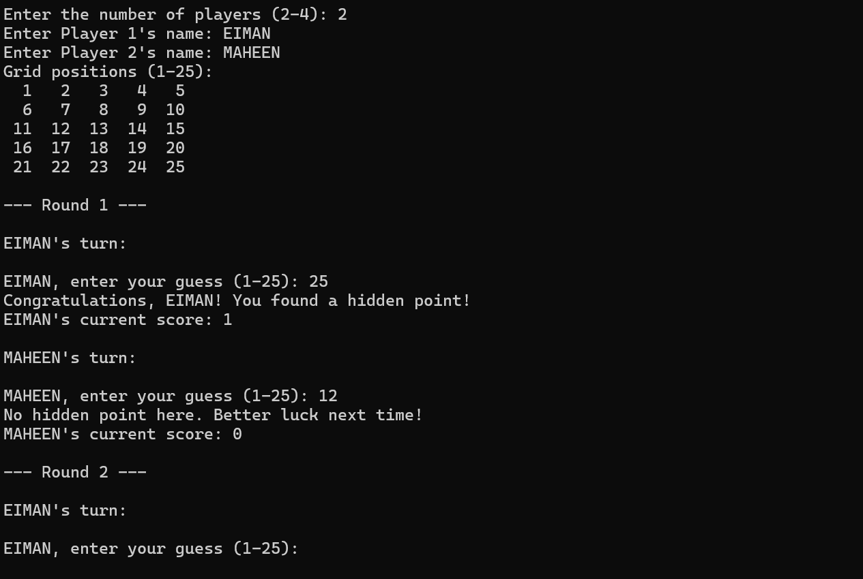

Slide 9
THANK YOU !!!

